Slide 1


Data Visualization
https://images.app.goo.gl/qgSB8guERE2WpodZA
Final Project Submission
Brazilian E-Commerce Public Dataset by Olist
https://www.kaggle.com/olistbr/brazilian-ecommerce
GROUP NAME: DATA VIS-ARDS
BY: HARD THAKKAR, KUNAL KALRA, MIREN PATEL, JOHN ROCK, HIWOT ARGAW

Slide 2
Agenda
Executive Summary
Description of the Company & the Dataset
Recap from Previous Analysis
Customer Analysis
Business Problem Identification
Based on our analyses, we discovered that Customer’s Drop Rate is a pressing problem for Olist. The rest of our analyses dives deeper into customer behaviour, their preferences, and factors potentially responsible for customers not repeating
Product Analysis
Category-wise Average Transaction Cost
Category-wise Average Customer Rating
What do customers repeat for?
Payment Analysis
Popularity of Payment Methods
Break-up of Transaction Value, Discounts, & Cancellations
Geospatial Distribution of Voucher Usage
Delivery Analysis
How successful deliveries vary over time
Factors influencing Delivery Times
Conclusion

Slide 3
Executive Summary
Key insights from the Analysis -
Customer Analysis:
Most customers bought only once from Olist, and very few came back for another transaction
Repeating customers was decreasing gradually, making Olist shortfall of revenue
Product Analysis:
Watches/gifts category had the highest average transactions cost
Most transactions ranged under 200$ across all categories
Average rating corresponded with the average delivery days per category
Ratings decreased as delivery days increased
Republic Day (National Holiday in Brazil) and Christmas caused delays
Payment Analysis:
Most popular payment method used for transactions is credit-cards
Bed_bath product category makes up for the most transaction count under voucher payment method
Delivery Analysis:
Number of days for delivery increases with increase of an order weight, freight value, and cost
The greater the count of order item the higher the overall payment value

Slide 4

Description of the Company & the Dataset
Description of the Company:
Olist is the largest department store in the Brazilian marketplace. With a single contract, Olist interfaces many small businesses around Brazil. This dataset is an open dataset, based on Brazilian ecommerce of all the orders made at the Olist Store.
Data Period Analysed:
The dataset has information of 99,441 orders from 2016 to 2018 made at multiple marketplaces in Brazil. However, period analysed for this final project is from September 2017 to August 2018.
The information is partitioned in numerous datasets for superior understanding and organization:
Customers Dataset - Data about the client and its location.
Geolocation Dataset- Data for Brazilian zip codes and its latitude/longitude arranges.
Order Items Dataset- Includes data about the items purchased inside each arranged order.
Payments Dataset: Data on orders payment options.
Order Reviews Dataset- Reviews made by customers
Orders Dataset - Core dataset. From each order you might find all other information.
Products Dataset - Data about products sold by Olist.
Photo of Data Schema. “Brazilian E-Commerce Public Dataset by Olist”, 22 Sept. 2020.https://www.kaggle.com/olistbr/brazilian-ecommerce/?select=olist_orders_dataset.csv

Slide 5
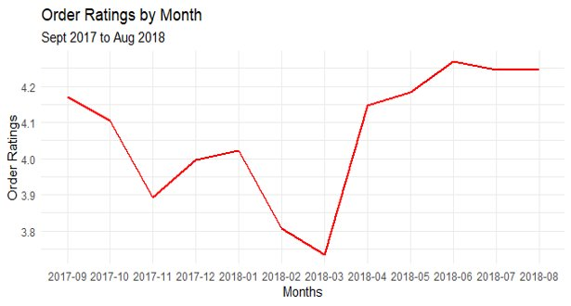
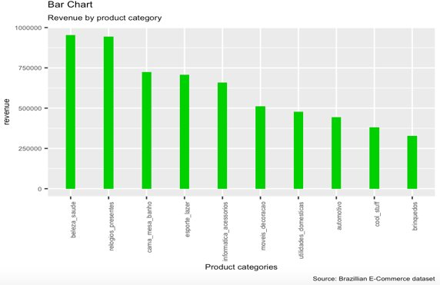
Recap From Previous Analysis
From the period analysed, the number of customers started to increase in November 2017 - March 2018, except for December 2017.
Sales increased consistently from March 2018 - May 2018.
November 2017 was when transactions shot up mostly likely due to Christmas and Republic Day in Brazil.
Avg. rating for orders serviced was 4.06/5, including cancelled orders.
Sales were concentrated in the south east region of Brazil.
Olist maintained over 6000 transactions every month starting from January 2018.
Olist received the most revenue from beauty/health products and gifts/watches.

Slide 6
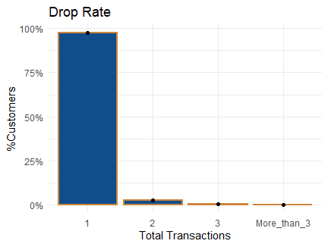
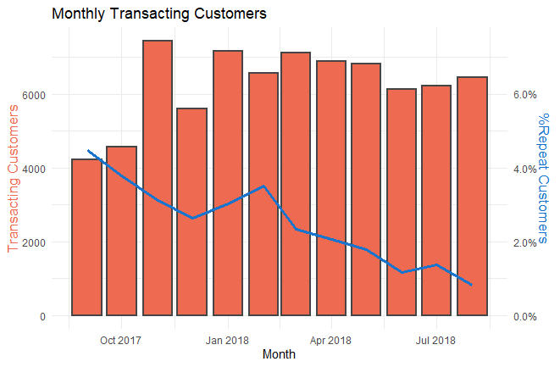
Customer Analysis
Business Question –
How many of the transacting customers at Olist are repeat customers, and what does their behaviour look like?
97.4% of 74k unique transacting customers did not repeat after the first transaction.
While transacting customers have generally grown with time, however, repeat transacting customers have declined from 4.5% in Sept’17 to 0.8% in Aug’18, which is very concerning

Slide 7
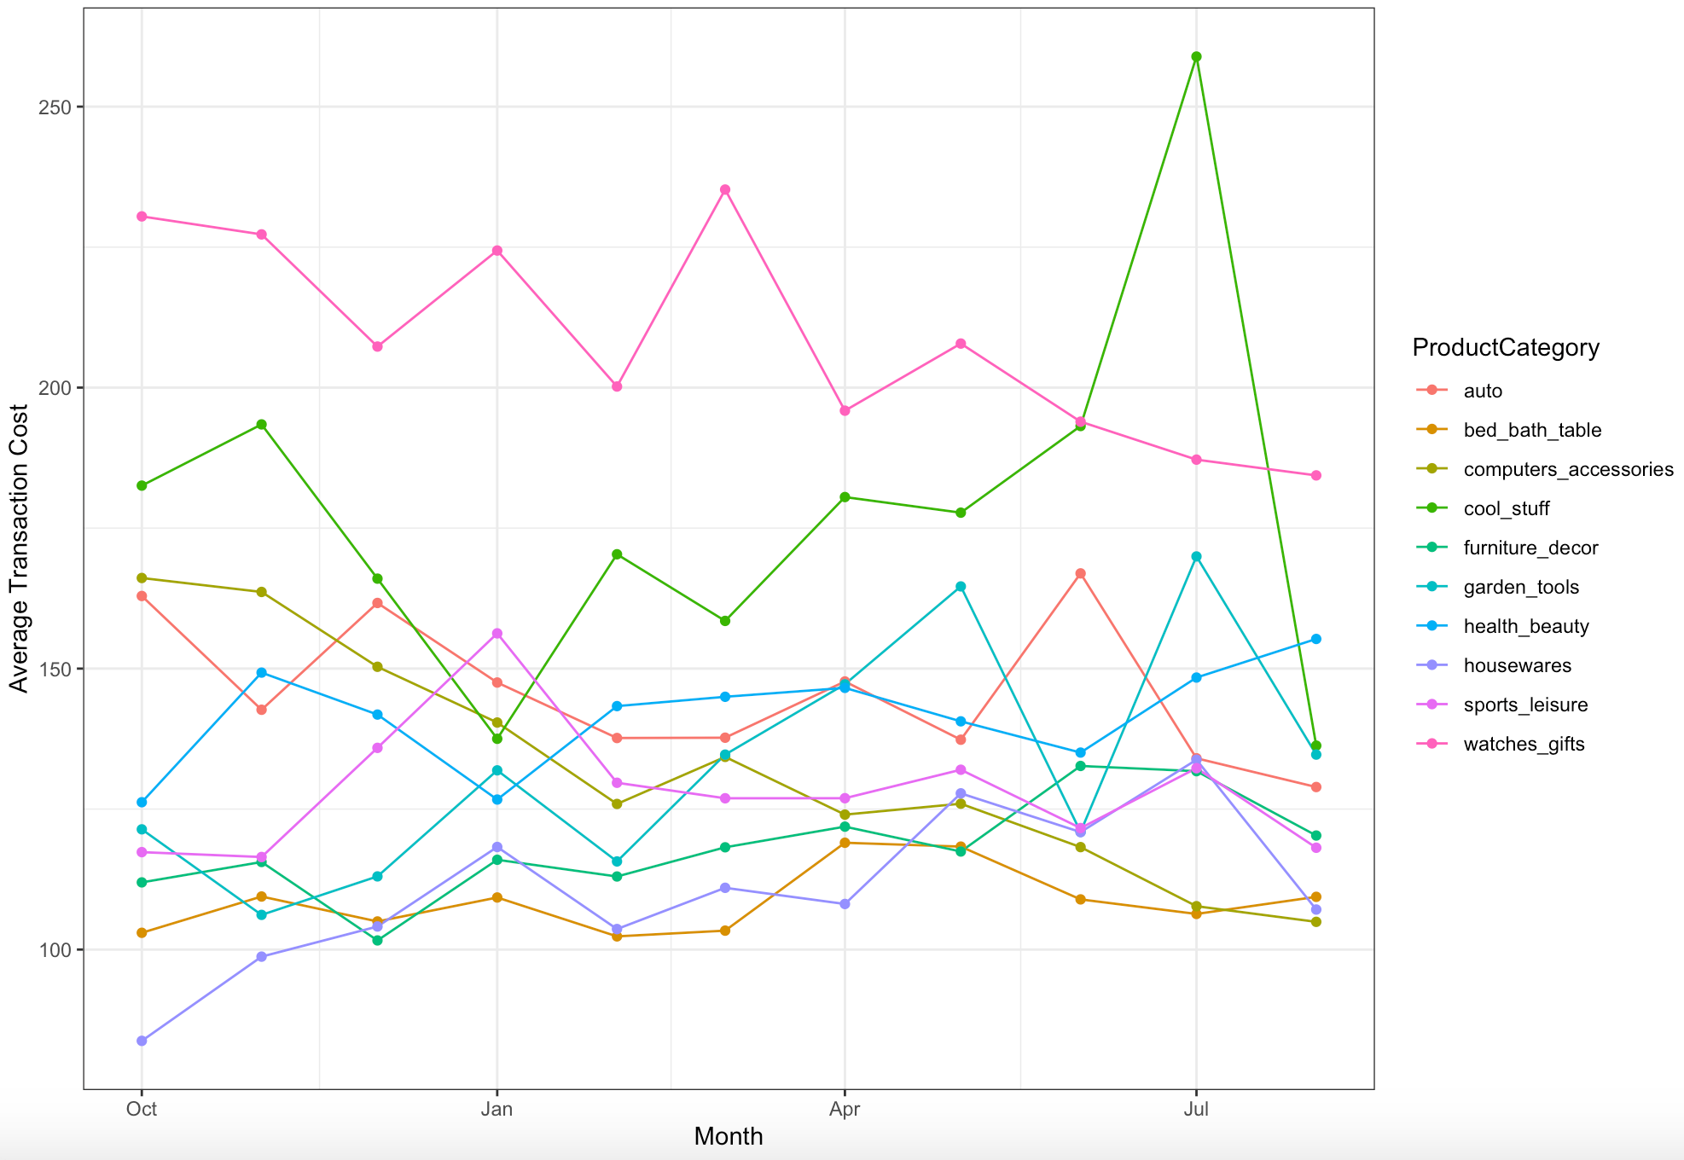
Product Analysis Category-wise Avg Transaction Cost
In the year we examined, most transactions remained in the 100 - 150 range across categories.
For most of the year, the watches_gifts category had the highest average cost per transaction, with average cost declining later in the year.
July saw a sharp upswing in the average transaction cost for cool_stuff before it dropped back to 100-150 range that most categories remained in.
Interestingly, the housewares category saw its average transaction cost grow substantially over the course of the year

Slide 8
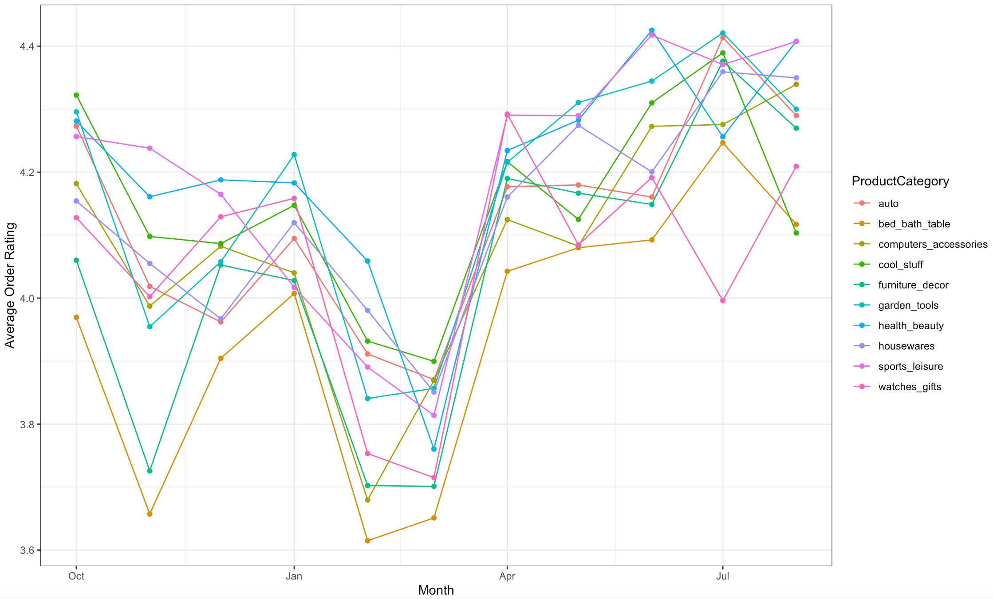
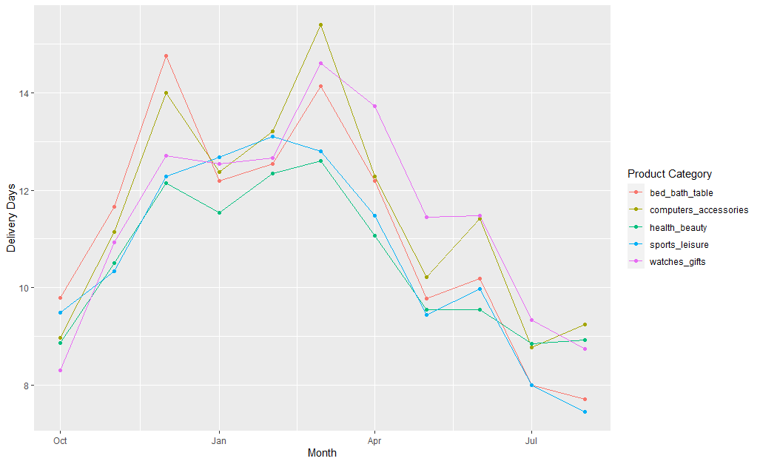
Product Analysis Contd. Category-wise Average Customers Rating
In general, average ratings for orders across categories hovered slightly above the 4.0 mark.
Ratings dropped precipitously before and after the holiday season at the conclusion of the year before rebounding
Delivery Days spiked in November-December most likely due to Republic Day and Christmas in Brazil.
Further analysis is needed but it seems plausible that the ratings drop corresponds with increased delivery times
http://localhost:16801/session/file46a85e740e3.gif
http://localhost:20694/session/file3aa45afb605a.gif
The dip in customer ratings around the holidays, could potentially be a contributing factor in customer not repeating.

Slide 9
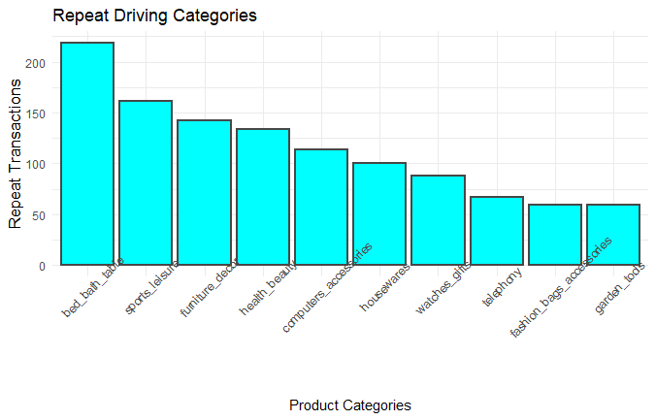
Product Analysis Contd. What Products do Customers Repeat for?
Bed and Bath is the top category in terms of driving repeat transactions
Health and beauty which is the top selling category in terms of revenue, ranks 4th in terms of driving repeat purchase behaviour
This analysis can help Olist identify marketing opportunities for campaigns to get customers to repeat

Slide 10
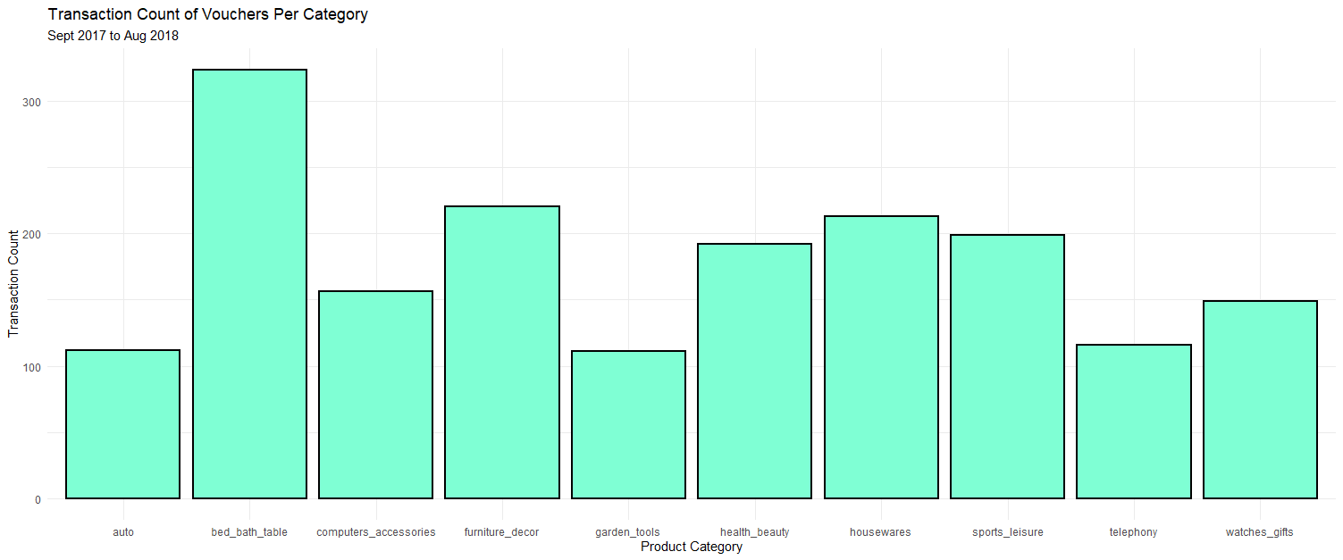
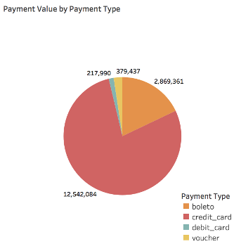
Payments Analysis
From the below pie chart we can observe that the most popular payment method is credit card with over $12 million in revenue, followed by boleto, which is an alternate payment method regulated by Brazilian Federation of Banks (FEBRABAN)
In the period analyzed above, bed_bath product category has over 300 transactions, making it the most popular category where vouchers were used

Slide 11
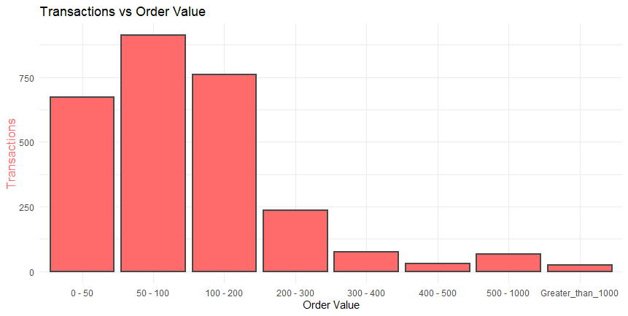
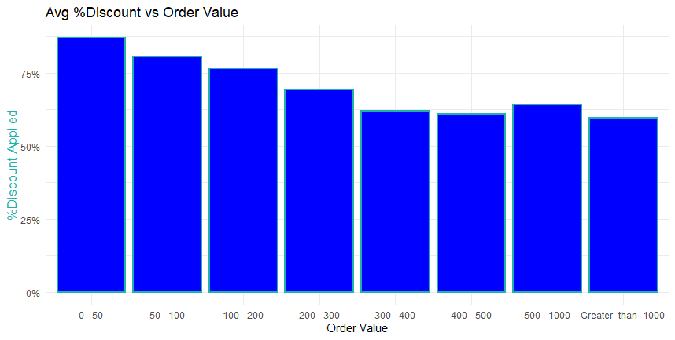
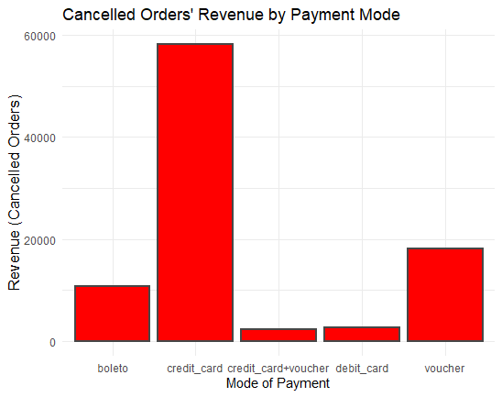
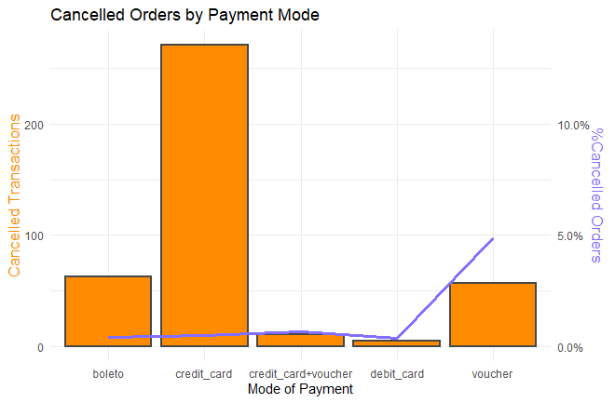
Payments Analysis Contd. Break-up of Transaction Value, Discounts, & Cancellations
Most transactions happen within the $50-$100 range.
In transactions where a voucher was applied, a discount was availed for up to 87% of the order value for the $50-$100 range.
Cancelled Transactions
In total 407 transactions were cancelled, totalling up to $92k in revenue.
Interestingly, nearly 5% transactions where a voucher was applied, got cancelled.

Slide 12
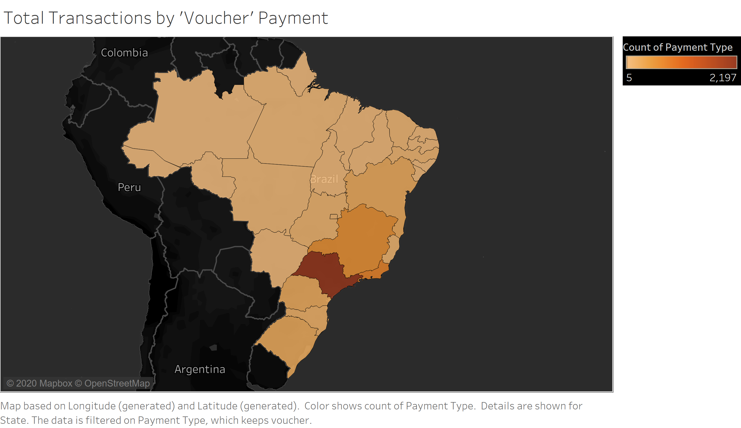
Payment Analysis Contd. Geospatial Distribution of Voucher Usage
mcm
The geospatial graph represents total transactions via "Vouchers" payment type
(Vouchers as a mode of Discount)
As mentioned before, Sao Paulo contains the highest number of transactions by "Voucher" payment method
North-Western regions of Brazil can be seen to have as little as 5 voucher transactions

Slide 13
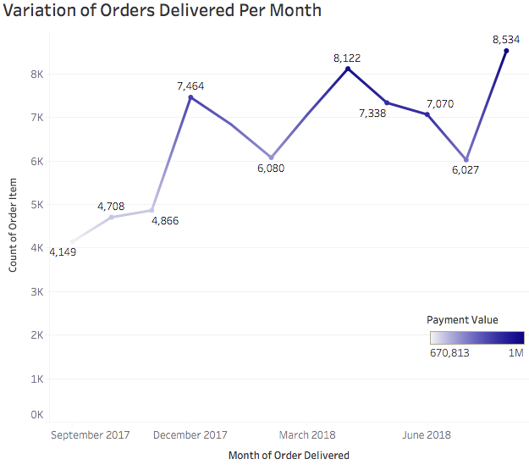
Delivery Analysis Variation of Orders Delivered
The overall trend for number of orders delivered to customer increased for the analyzed time period between September 2017 to August 2018.
From our analysis, August 2018 shows the highest order item delivery of 8,534, with a payment value of over 1 million.
Positive correlation in the relationship between count of order item and payment value.

Slide 14
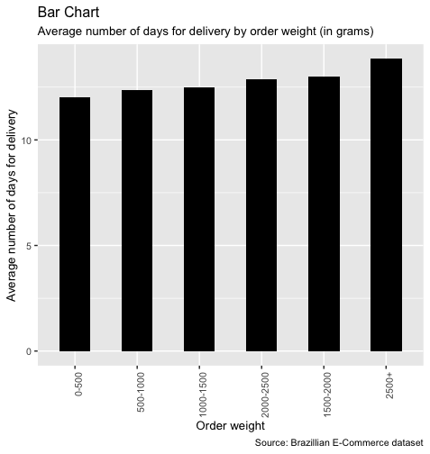
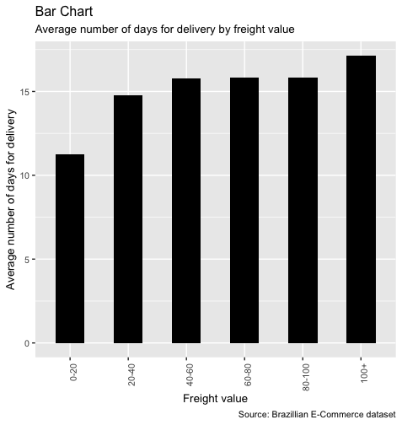
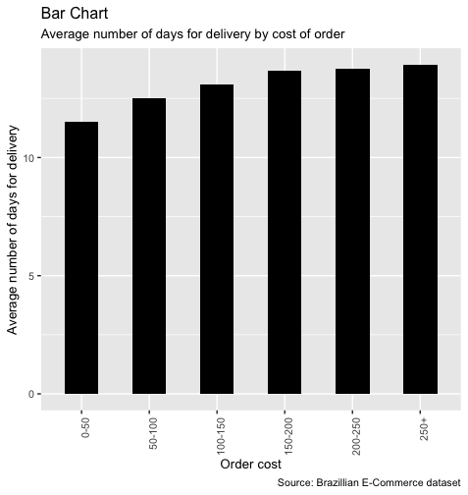
Delivery Analysis Contd What Impacts Delivery Times?
As order weight, freight value, and cost of an order increase, the average number of days needed for delivery increases as well
This is unsurprising as it is likely more difficult to transport larger and more costly items
With freight value, average delivery time can vary by more than a week across the intervals so investigating ways to more quickly transport items with higher freight values sticks out as an aspect that needs improvement

Slide 15
Suggestions for Olist
Olist could initiate a Loyalty Program, focused on rewarding customers for repeating. This would help Olist drive customer retention in the long run.
Discounts/deals on least selling items could also help to further drive sales
We could further analyse items that were often bought together and promote them as bundled offers to drive cross-sell. Personalized recommendations could be provided once Olist has enough data to identify customer preferences
Improving efficiency in delivery could also benefit the e-commerce website.
As a long-term strategy, having solved customer issues within areas that contribute the most sales, Olist could investigate allocating resources to expanding operations outside of Sao Paulo.

Slide 16
Thank You! Do you have any questions?

